Slide 1

Analysing Rice Seed Quality using
Machine Learning
Submitted by
Ms. Anjali C. Hadke
M.Sc. Semester IV (CS 4P2)
2022
Under the Guidance of
Dr. Mrs. A.D. Sakhare
Department of Electronics and Computer Science,
Rashtrasant Tukadoji Maharaj Nagpur University,
Nagpur – 440 033

Slide 2
Contents:
Introduction
Problem Statement
Review of Literature
Methodology
Experimental work
Result
Conclusion
Advantages
Limitation and future scope
Reference

Slide 3
Introduction:
The proposed system represents the solution of grading & evaluation of rice quality on the basis of grain shape and size
Rice Quality
Aim of the Project is to Find proper solution for analysing quality of rice in less time and cost.
Traditional Method
Image Processing Technique
Length/Breadth = [(Avg. length of rice)/(Avg. breadth of rice)]*100

Slide 4
Problem Statement:
In agricultural industry quality analysis of product is very important.
Quality of grain seeds is analysed visually by experienced technician. But the outcome of such measurement is relative, varying in results and time consuming.
The quality also gets affected by the errors of technician; so to overcome the shortcomings occurred due to traditional methods new and advanced technique i.e. image processing technique is proposed.

Slide 5
Review Of Literature:
Authors | Title of Project | Technique or Methodology used
Bhagyashree Mahale, Prof. Sapana Korde | Rice Quality Analysis Using Image Processing Techniques | Image processing and analysis
VidyaPatil, V. S. Malemath | Machine Vision based Quality Analysis of Rice Grains | Evaluation and grading of rice grains
Benjamaporn Lurstwut and Chomtip Pornpanomchai | Rice Seed Germination Analysis | Image processing technique
Dr. T. Avudaiappan, S.Sangamithra, A.Silpha roselin, S.Sherin farhana, KM.Visalakshi | Analysing Rice Seed Quality Using Machine Learning Algorithms | Artificial Neural Network (ANN) , Support vector machine
Anurag Sinha | Dimension Analysis and Gradation of Rice Grain using Image Processing Technique | Machine learning gradation

Slide 6
Methodology:
Image Acquisition
Pre-processing
Shrinkage Morphological Image
Grading
Edge Detection
Object Measurement

Slide 7
Grading:
All standard, measured, and calculated results are required for classification. The laboratory manual on rice grain quality refers to the standard database for rice size and shape measurement.
The following tables provide the classification of rice grains according to the standard database. Table 1 shows how rice grains are classified based on length and length-to-breadth ratio. Table 2 shows how grains are classified based on their length, which determines the size of the grain. Table 3 classifies grains according to their length-to-breadth ratio, with slender, medium, bold, and round grains determining the shape of the grain. The tables below are used to categorise rice grains into distinct categories.

Slide 8
Table 1: Classification of Rice Grain
Long Slender (LS) | Length 6 mm and above, L/B ratio 3 and above
Short Slender (SS) | Length 6 mm and above, L/B ratio 3 and above
Medium Slender (MS) | Length less than 6 mm , L/B ratio 2.5 to 3.0
Long Bold (LB) | Length 6 mm and above, L/B ratio less than 3
Short Bold (SB) | Length less than 6 mm, L/B ratio less than 2.5
Table 2: Classification on the Basis of Length Table 2.3: Classification on the Basis of L/B Ratio
Grain Size | Length(mm)
Extra-Long | >7.5
Long | 6.61-7.7
Medium | 5.51-6.6
Short | 5.5 or less
Grain Size | L/B ratio
Slender | Over 3
Medium | 2.1-3
Bold | 1.1-2
Round | 1 or less

Slide 9
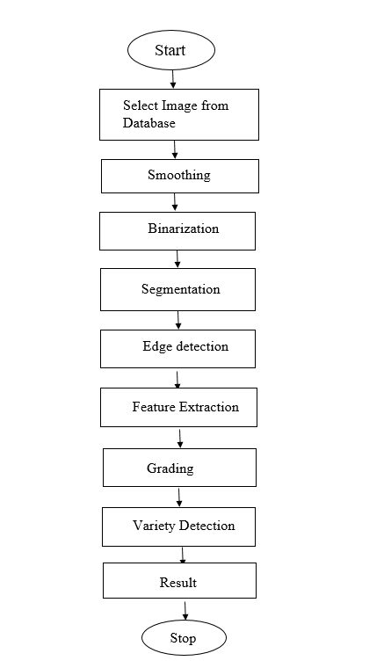
System Work Flow Diagram:

Slide 10
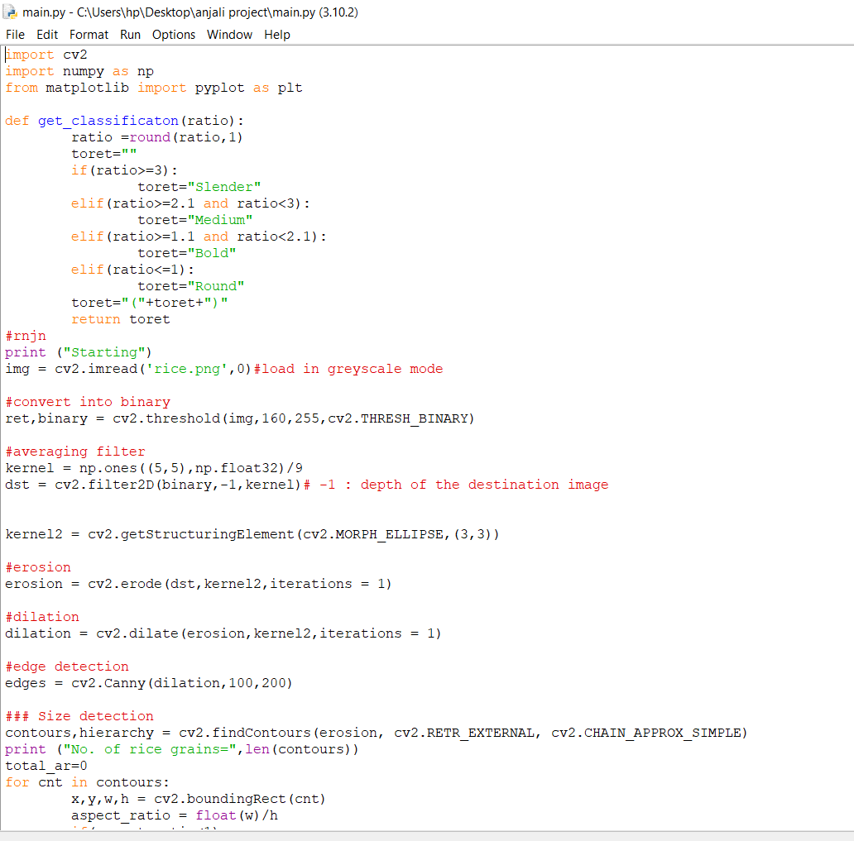
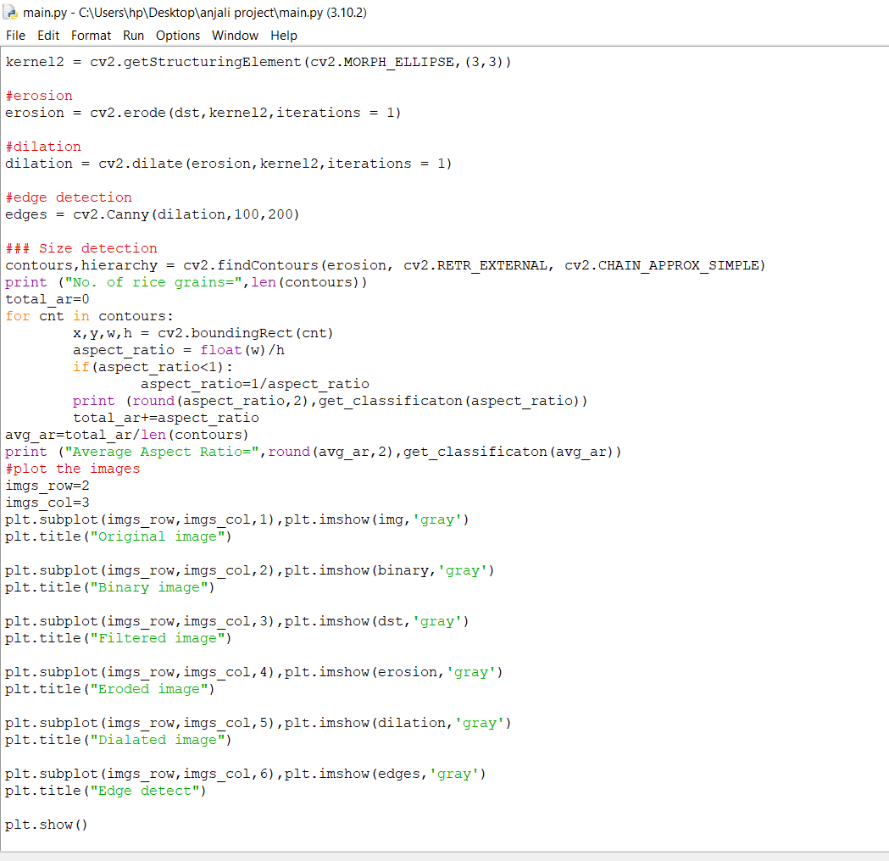
Experimental Work:
Input: Rice Seed Images from Database in our python code

Slide 11
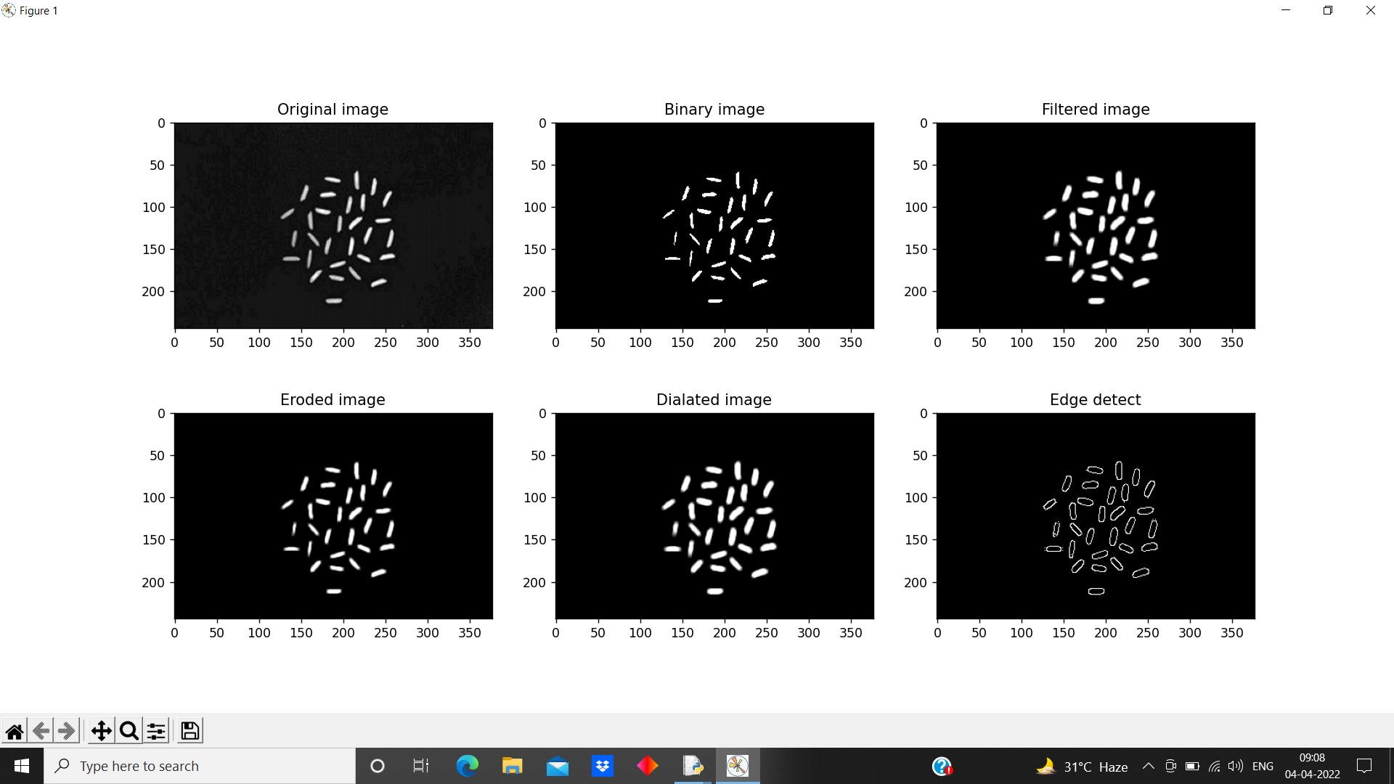
Output of the above mentioned code:

Slide 12
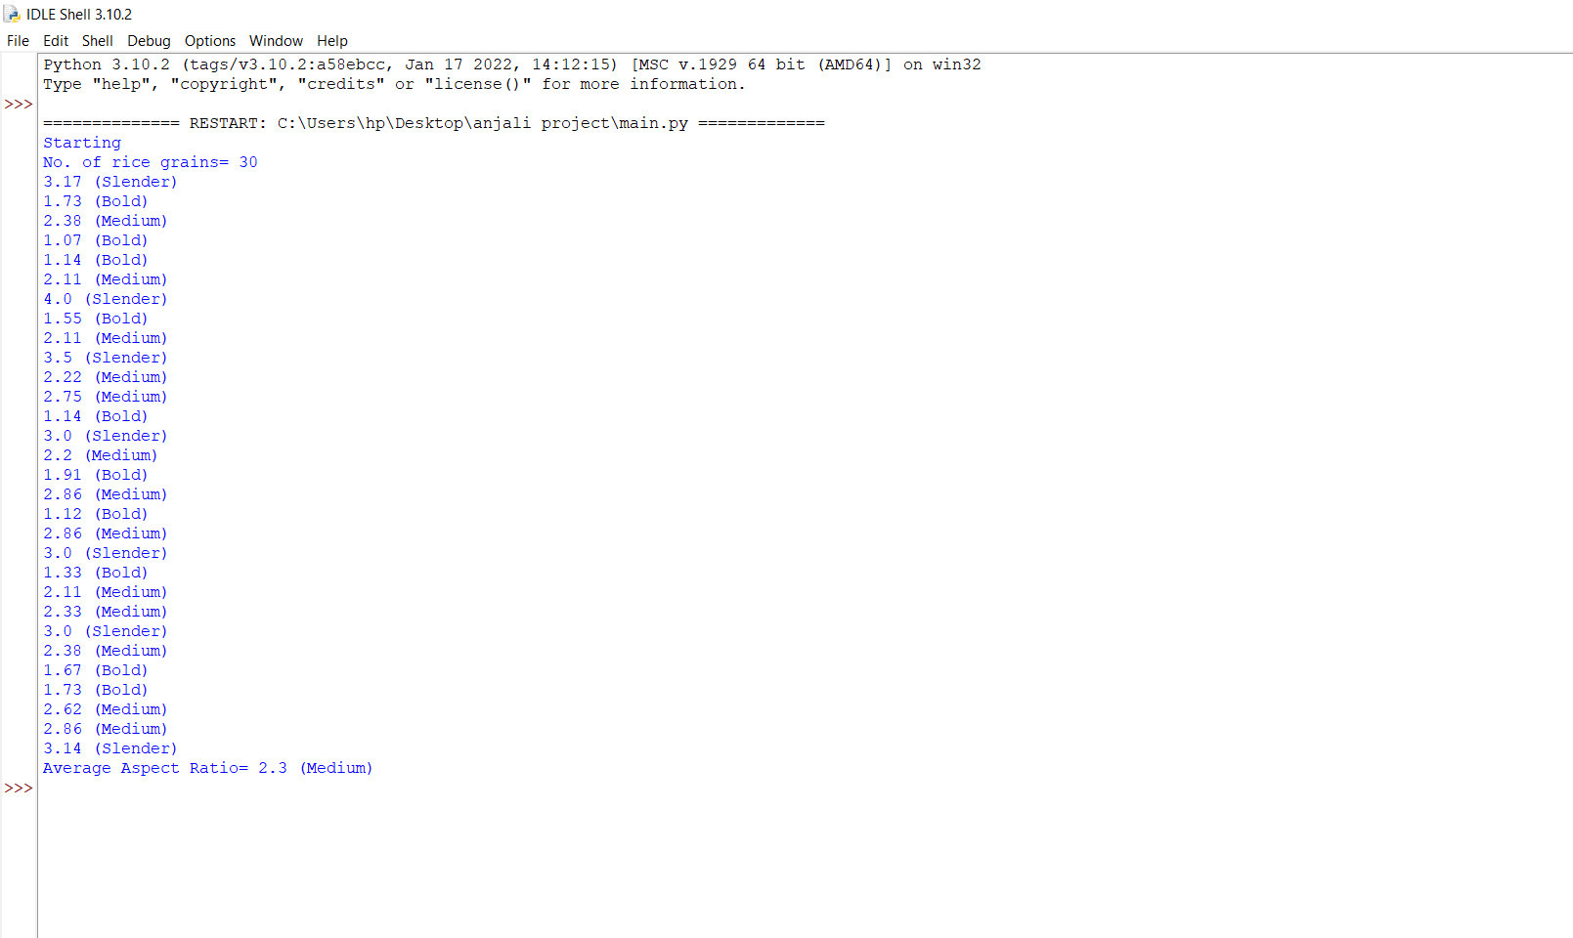
Rice Seed quality grading after calculating length/breadth:

Slide 13
Result and Discussion:
The image analysis methods are applied on a single layer of rice grains that are randomly arranged and spread. If an error such as touching kernels happens. The shrinking operation is effective in separating the materials. From the place where the kernels touch, a connecting portion is created. To determine the region of boundaries, edge detection is used and each grain's ends; and finally, utilising the length and width of callipers can be measured. Following that the length and breadth values, and the length-breadth ratio must be computed.
Sr.No. | Number of grain | L/B ratio | Sr.no. | Number of grain | L/B ratio
1 | Grain 0 | 3.04 | 16 | Grain 15 | 3.16
2 | Grain 1 | 3.52 | 17 | Grain 16 | 3.05
3 | Grain 2 | 3.24 | 18 | Grain 17 | 3.36
4 | Grain 3 | 2.95 | 19 | Grain 18 | 3.27
5 | Grain 4 | 3.26 | 20 | Grain 19 | 3.04
6 | Grain 5 | 3.16 | 21 | Grain 20 | 3.77
7 | Grain 6 | 3.14 | 22 | Grain 21 | 3.01
8 | Grain 7 | 3.18 | 23 | Grain 22 | 3.02
9 | Grain 8 | 3 | 24 | Grain 23 | 3.68
10 | Grain 9 | 3.2 | 25 | Grain 24 | 3.37
11 | Grain 10 | 3.11 | 26 | Grain 25 | 3.39
12 | Grain 11 | 2.96 | 27 | Grain 26 | 3.02
13 | Grain 12 | 3.07 | 28 | Grain 27 | 3.17
14 | Grain 13 | 3.42 | 29 | Grain 28 | 3.1
15 | Grain 14 | 3.28 | 30 | Grain 29 | 3.2
Table : Length/breadth ratio

Slide 14
Conclusion:
Rice grain samples were captured using a physical cover with a camera and a front-lighting system, and the proposed algorithm processed the images to extract the grains' physical characteristics. According to the results, it is proved that the proposed system process rice grains can analyse rice quality in a short period of time than manual inspection with good accuracy result. Furthermore, rice seed analyse method provides a solution to measure 2D area of rice grains to identify rice quality and broken grains.
The main Objective of this project is to develop an effective model which helps to analyse rice grains without labour intensifying work. From the obtained results, it can be concluded that the use of machine learning is an efficient method to analyse rice seed quality.

Slide 15
Advantages:
Farmers can get rice quality analysed
It can be used in seed testing laboratory
One can check seed quality at home
Determination of rice quality used for planting

Slide 16
Limitations of present work:
Rice Seed should be equally spread and they should not touch with each other.
Image of Rice seed should be clear.
Scope for future work:
In future, it can be used to classify various rice grain by developing an automated system using image analysis.
Also we can calculate various parameters for quality analysis and classify them into normal, small & long rice seed.

Slide 17
References:
[1] Bhagyashree Mahale, Prof. Sapana Korde (2014), “Rice Quality Analysis Using Image Processing Techniques”, International Conference for Convergence of Technology, 978-1-4799-3759-2/14/$31.00©2014 IEEE.
[2] VidyaPatil, V. S. Malemath(2015), “Machine Vision based Quality Analysis of Rice Grains”, International Journal of Innovative Research in Computer & Communication Engineering (IJIRCCE) ISSN 2320-9801, Vol. 3,Issue 6, pp5672-5678, June 2015.
[3] Benjamaporn Lurstwut and Chomtip Pornpanomchai (2016), “Rice Seed Germination Analysis”, International Journal of Computer Applications Technology and Research Volume 5– Issue 4, 176 - 182, 2016, ISSN:- 2319–8656.
[4] Dr. T. Avudaiappan, S.Sangamithra, A.Silpha roselin, S.Sherin farhana, KM.Visalakshi (2019), “Analysing Rice Seed Quality Using Machine Learning Algorithms”, SSRG International Journal of Computer Science and Engineering ( SSRG – IJCSE ) – Special Issue ICRTCRET Mar 2019, Page 22-26, ISSN: 2348 – 8387
[5] Anurag Sinha (2020), “Dimension Analysis and Gradation of Rice Grain using Image Processing Technique”, International Journal for Modern Trends in Science and Technology, 6(10): 69-73, 2020, ISSN: 2455-3778 online.
[6] G.M.K.B. Karunasena, H.D.N.S. Priyankara, B.G.D.A. Madhusanka (2020), “Machine Vision Techniques for Improve Rice Grain Quality Analyzing Process”, International Journal of Innovative Science and Research Technology, Volume 5, Issue 6, June – 2020, ISSN No:-2456-2165.

Slide 18
[7] Teresa Mary Philip, H. B. Anita (2017), “ Rice Grain Classification using Fourier Transform and Morphological Features” , Indian Journal of Science and Technology, Vol.10, Issue 14, DOI: 10.17485/ijst/2017/v10i14/110468.
[8] Zahida Parveen, Muhammad Anzar Alam, Hina Shakir (2017), “Assessment of Quality of Rice Grain using Optical and Image Processing Technique”, International Conference on Communication, Computing and Digital Systems, 978-1- 5090-4448-1/17/$31.00 ©2017.
[9] Kuchekar. N.A, Yerigeri.K.K (2018), “Rice Grain Quality Grading Using Digital Image Processing Techniques” , IOSR Journal of Electronics and Communication Engineering, Vol. 13, Issue 3, e-ISSN: 2278-2834, DOI: 10.9790/2834- 1303018488
[10] Samrendra K Singha, Sriram K Vidyarthi, Rakhee Tiwarib (2019), “Machine learnt image processing to predict weight and size of rice kernels”, Journal of Food Engineering, Vol 274, https://doi.org/10.1016/j.jfoodeng.2019.109828
[11] Dr. T. Avudaiappan, S.Sangamithra, A.Silpha roselin, S.Sherin farhana, KM.Visalakshi (2019), “Analysing Rice Seed Quality Using Machine Learning Algorithms” , SSRG International Journal of Computer Science and Engineering, ISSN: 2348 – 8387.
[12] Kantip Kiratiratanapruk, Pitchayagan Temniranrat, Wasin Sinthupinyo, Panintorn Prempree, Kosom Chaitavon, Supanit Porntheeraphat, Anchalee Prasertsak (2020), “Development of Paddy Rice Seed Classification Process using Machine Learning Techniques for Automatic Grading Machine”, Journal of Sensors, Vol. 2020, Article ID 7041310, 14 pages, https://doi.org/10.1155/2020/7041310.

Slide 19
Thank You

